Slide 1
NFL Betting Data
Josh Ness
Sports betting with data-driven decisions

Slide 2
Business Goal
Business goal: To build a comprehensive data pipeline to allow for in depth analysis of NFL statistics and betting odds. The long-term goal is to provide data-driven insights through a marketable app towards bettors.
- Pipeline should allow for addition of other sports in the future
Quick statistics
In 2020, 61.6% of online gambling revenue came from sports betting.
By 2024, the global sports betting market is expected to be valued at 155.48 billion USD. That is more than the combined worth of every NFL team.
Online sports betting market is predicted to maintain a 14.6% compound annual growth rate through 2030.
Source: Must-Know Sports Betting Statistics [Latest Report] • Gitnux

Slide 3
Architecture Diagram
Ingestion
Azure Blob Storage
SQL Server
Serving
Data loaded into staging tables
PowerBI interactive visualizations
Dataset 1 - NFL Data
Container 1 - NFL Data
Stored procedure transforms data and inserts into star schema
Future: Marketed application
Dataset 2 - Betting Odds
Container 2- Betting Odds
Minor, lightweight data manipulation
Azure Functions
Blob Trigger Functions
Column selection and column names
Soon: Function to execute SQL procedure
Logging

Slide 4
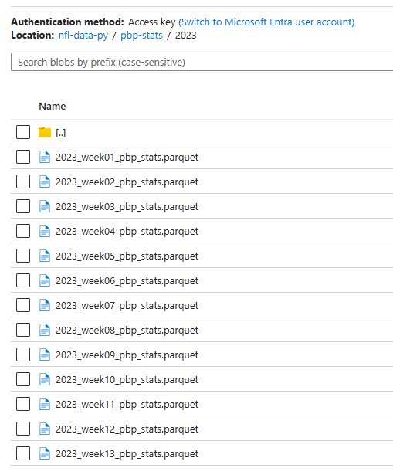
Ingestion overview
Dataset One
Python script loads data from client library in four different DataFrames [PlayByPlay, Injuries, Schedules, Rosters]
Data is loaded for entire current season (by force) but gets condensed to most recent week
Time zone normalization
Each table gets sent to a custom “upload_file” function that maps the table to its location in Azure. The function uses a buffer to upload the file without it ever being stored in local storage
Logging throughout entire process
Dataset Two
Python script requests player-props betting data from API and response is loaded into a DataFrame
JSON contained within DataFrame is flattened
Mapping adds week to the data
Time zone normalization
Table gets sent to a custom “upload_file” function that maps the table to its location in Azure. The function uses a buffer to upload the file without it ever being stored in the local storage
Logging throughout entire process

Slide 5
Transformation overview
Azure Functions
SQL Wrangling
Blob Trigger Functions detect any new files within Azure storage account
Betting odds data combines various values of associated players to create a unique ID for each player
Betting odds player ID merged onto similarly crafted column of player table of dataset 1 to obtain reliable playerID
Blob Trigger Functions detect any new files within Azure storage account and automatically loads into a DataFrame
Minor transformations such as converting field goal result strings to 0 or 1
Unnecessary columns are dropped
All data is wrangled into the star schema defined
New data is inserted. If the PK already exists, it checks for differences and updates
Custom function crafts a BULK INSERT SQL query by using column names
If any issue arises during the process, it is logged in an error table
Data dropped from staging tables after success
Data is inserted into staging tables
Stored Procedure

Slide 6
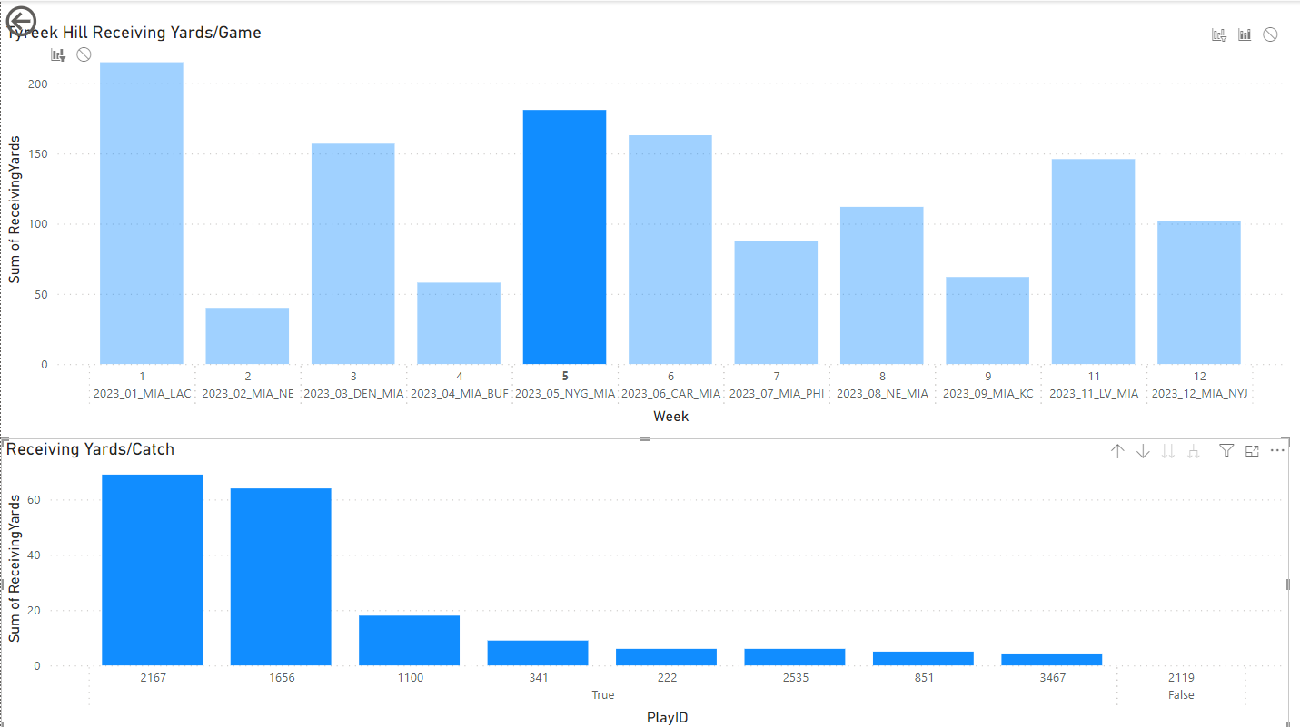
Serving Overview
PowerBI connected to the database
Visualization will be made to allow easy in-depth analysis of any player and any potential bet
To the right, is just a basic level example of a single players receiving stats at a high level compared to what is possible

Slide 7
Key technologies and challenges
Technologies
Python & libraries
Azure Blob Storage
Azure Functions
SQL Server
PowerBI
Challenges
Player mapping between datasets
Especially hard since data sources for player props are relatively new and actively being improved.
Player information within my API source was limited
Datetime normalization
SQL Inexperience

